Slide 1
Agile Development Processes (EDA397/DIT191)
Erik Knauss (Examiner)
Emil Alégroth (Teacher Assistant)

Slide 2
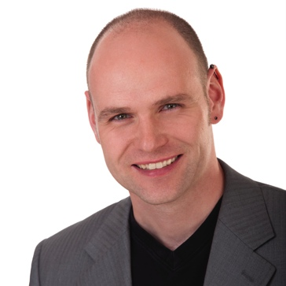
Introductions
Currently on a conference. Will introduce himself when he gets back!
Research:
Requirements Engineering
Agile methods
RE and Project Management
Experience and Knowledge Management
Eric Knauss

Slide 3
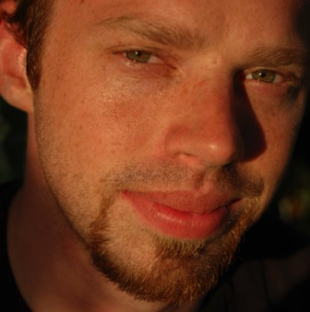
Introductions
MSc 2010 (Software Engineering)
Phd Candidate 2011
Licenciate degree 2013
Planned PhD September 2015
Research:
Automated testing
Model based testing
Alignment between requirements and tests
Agile software development course
Teacher assistant in the course since 2011!
Emil Alégroth

Slide 4
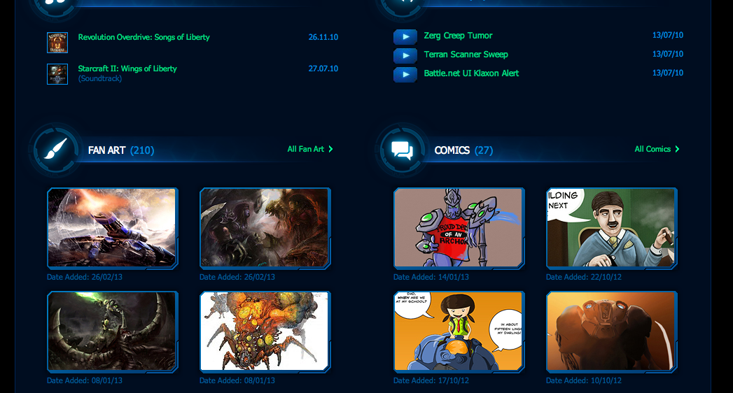
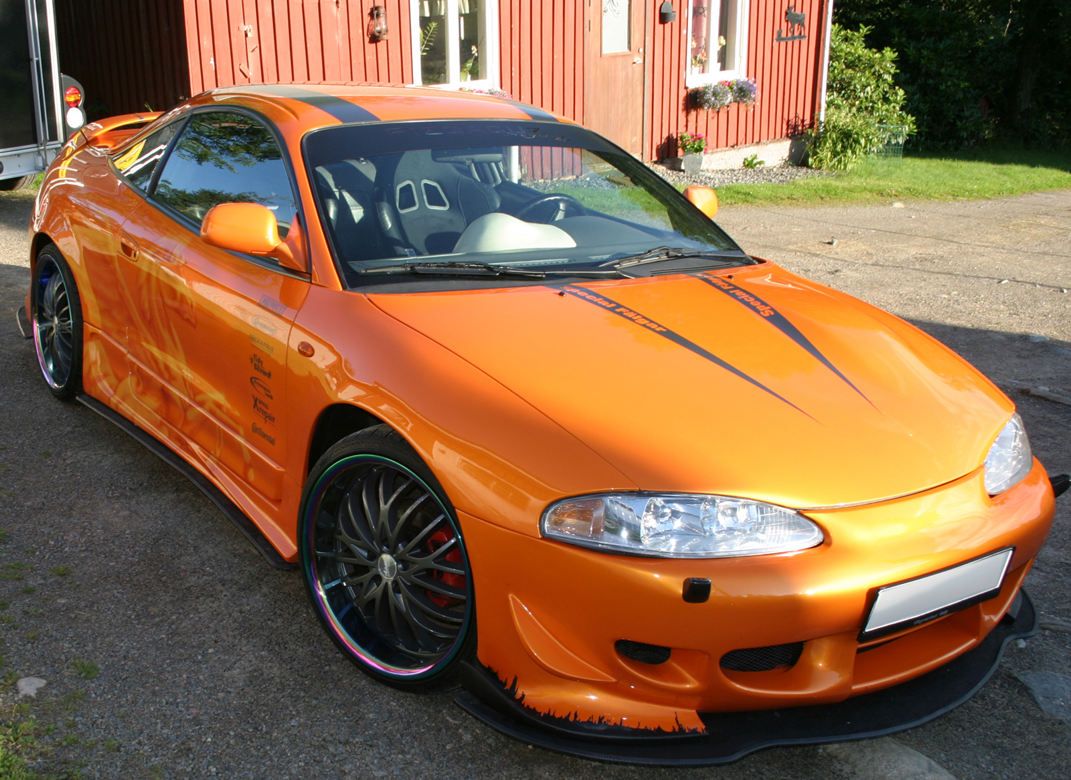


Slide 5
General information
If you have any questions or comments send an e-mail
Emil.alegroth@chalmers.se
I answer as quickly as I can, but since I am busy it might take a day or two!
You can also visit my office on the 4th floor in house Jupiter
Time constraints.
Tell us ALL your problems with the course, fellow students, etc. But do so as quickly as possible!

Slide 6


Course information
Course representatives
Christos Charalmpous
Markus Ekström
Linus Lindgren
Jing Wang
We need a GU student to volunteer!
Course Materials
http://oerich.github.io/EDA397/
Cockburn,A., (2009) Agile Software Development, 2ed
Papers

Slide 7
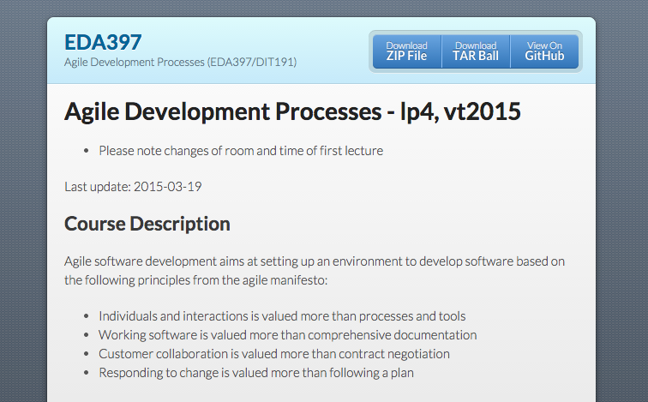
Course Webpage
http://oerich.github.io/EDA397/

Slide 8
Course setup
Schedule
0-3 lectures per week
0-2 workshops per week
=3 scheduled activities per week
Even if there is no lecture, we will be available and you can (should!) use the rooms/time to work!
Examination
Project (teams)
Final product – You need to deliver something
Artifacts
Experience / Post-Mortem report
Written exam

Slide 9
Project
Develop an Android app for a customer
Work in predetermined teams
You will be assigned teams
We start with eXtreme programming
Then we add some other practices
You meet with the customer during course week 2
and get all the requirements!
We strive to create a realistic scenario/ environment
We rely on a number of real-world services and tools, e.g.
Android (SDK) GitHub / BitBucket ..

Slide 10
Teams
Teams will be randomly selected: NO EXCEPTIONS!
Sign paper that has been sent around the room
Name
Personal number / Social security number
E-mail address
Development experience
Thursday: Lecture where you will be assigned groups
Preferably meet your group members!
Friday: Get started in your groups

Slide 11
Course Objectives
Knowledge and understanding | Skills and ability | Judgement and approach
Compare agile and traditional softw. dev, | Forming a team organically | Explain: people/commun. centric dev.
Relate lean and agile development | Collaborate in small software dev. teams | Apply fact: people drive project success
Contrast different agile methodologies | Interact and show progress continuously | Describe: No single methodology fits all
Use the agile manifest and its accompanying principles | Develop SW using small and frequent iterations | Discuss: methodology needs to adopt to culture
Discuss what is different when leading an agile team | Use test-driven dev. and automated tests
 | Refactor a program/design
 | Be member of agile team
 | Incremental planning using user stories

Slide 12
Dev team 1
Dev team 2
Dev team 3
Saab
Ericsson
What you will learn…
Agile Software development

Slide 13
Examination
Written exam, individual, 3.0 credits
60 points, 24 required to pass
Grades
Chalmers:
[0-49%] → Fail,
[50-64%] → 3,
[65-79%] → 4,
[80-100%] → 5
GU
[0-49%] → Fail,
[50-79%] → G,
[80-100%] → VG

Slide 14
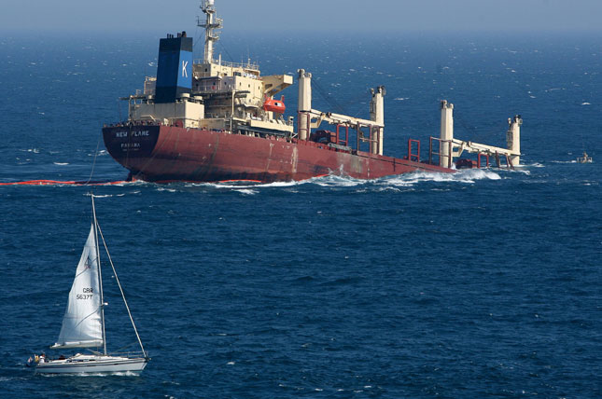
What is agility in Software Development?
Agile: An Overview

Slide 15
Some quick questions
Do you know how to write software (Java, C, C++, etc)?
Have you been in a student project and written software?
Have you worked as a software developer?
Have you worked according to a software development process?
Have you worked according to an agile software development process?

Slide 16
Taxonomy
Product
The software system we are developing,
e.g. Spotify, Photoshop, Facebook
A limited time activity when we add new, or change,
functionality to a product. Results in a new or
changed product.
Project
The way we work during the project to add or change
the product’s functionality. Consists of a set of
activities also referred to as practices.
Process
A specific activity performed in a process,
e.g. requirement elicitation, pair-programming,
refactoring, system testing, etc.
Practice

Slide 17
All together
We develop a Product in Project(s) using
a Process that consists of Practices!
Often in iterations!

Slide 18
Development in teams
OBS! JUST EXAMPLES!
10.000+ LOC
Developer
50.000+ LOC
Developers
x5
100.000+ LOC
Dev/Arch/Test
x50
1.000.000+ LOC
RE/Dev/Arch/Test
X500+
Many million LOC
Massive organ.
Organizations need processes

Slide 19
Motivation for Software engineering
What is the “Software crisis”?
Software development inefficient
Software does not meet requirements
Projects over time/budget
Projects were unmanageable and software unmaintainable
What can be done about it?
Software Engineering
Application of engineering to Software
Systematic, disciplined, quantifiable approach to the development, operation, and maintenance of software
Assure quality of process and product

Slide 20
Traditional Software development
Requirements elicitation/Design
Development
Testing/Verification/Validation
Interviews with customer
Write requirements
Turn requirements into tasks
Model the system
Write code
Unit testing
Integration testing
System Testing
Acceptance Testing

Slide 21
Systematic sequential development
Requirements
Design
Programming
Test
Advantages
Simple
Controllable
Cost efficient
Problems
Time-to-market
What about change?

Slide 22
Towards concurrent development
Requirements
Design
Programming
Test
What can we do if time to market and robustness against late changes are more important than cost-efficiency?
Requirements
Design
Programming
Test
Time-to-market
Time-to-market

Slide 23
Iteration Models
System requirements always evolve during a project
Iterations are part of larger development projects
Iterations can be applied to any generic development process model

Slide 24
Incremental delivery
Define outline requirements
Assign requirements to increments
Design system architecture
Develop system increment
System incomplete
Validate increment
Validate system
Integrate increment
Final delivery

Slide 25
Incremental delivery
Customer value can be delivered with each increment so system functionality is early available for customer’s feedback
Early increments act as prototype to help elicit requirements for later increments
Reduced risk of project failure
The highest priority system services tend to receive the most testing

Slide 26
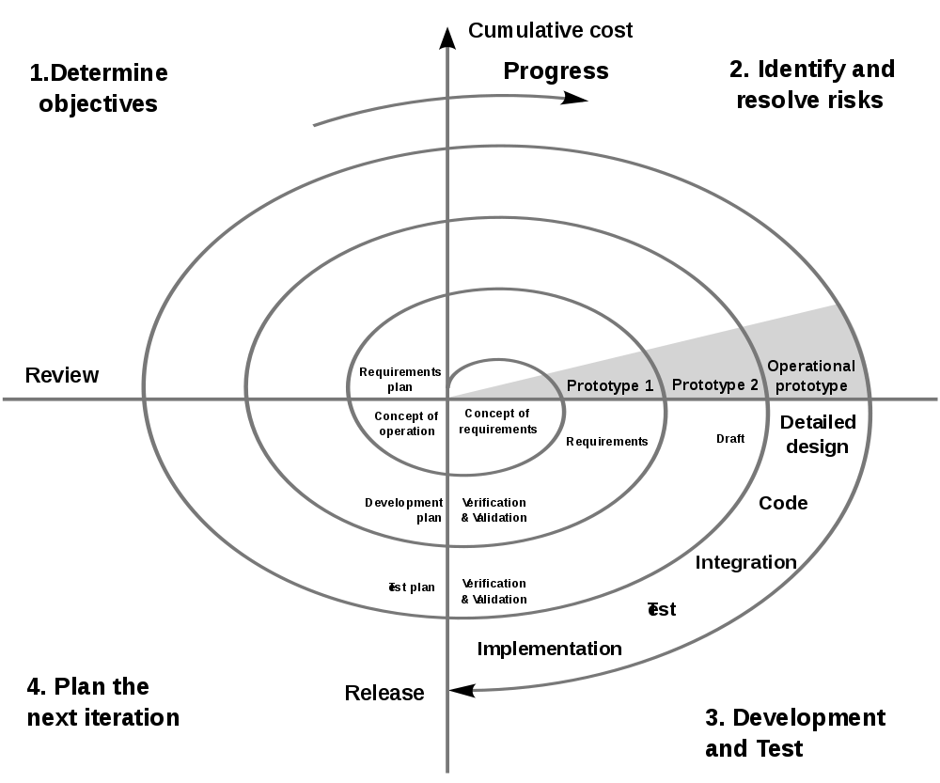
Spiral Model [Boehm]
Rather quadrants than axis
Distance to center: Progress
Utility
Iteration: Risk reduction
Spiral: Time, Process
Notes:
Williams Opoku
Email: opowilliams@yahoo.com
Soc: 740714-0636

Slide 27
Spiral development
Objective setting
Specific objectives for the phase are identified
Risk assessment and reduction
Risks are assessed and activities put in place to reduce the key risks
Development and validation
A development model for the system is chosen which can be any of the generic models
Planning
The project is reviewed and the next phase of the spiral is planned

Slide 28
?
Is the Spiral model agile?
What kind of prototypes will be developed in the Spiral model?
Is consecutive prototyping agile?

Slide 29
What is a prototype?
Why was it constructed?
Presentation- PT
Actual PT
Laboratory sample
Pilot system
Explorative
Experimental
Evolutionary
Horizontal
Vertical
How do end-users/colleagues/you like the PT?
What was learnt or experienced during construction / presentation of prototype?
+/-
What is the contribution of the prototype?
What is (only) infrastructure?
Technical knowledge during the process that can be valuable somewhere else
Notes:
Die Folie weist darauf hin, dass es auch noch andere Klassifikationen nach anderen Kritierien gibt.
So spricht man von horizontalen Prototypen, wenn „die Breite“ der meisten Funktionen abgedeckt, diese aber nur relativ oberflächlich umgesetzt werden. Vertikales Prototyping geht in einem eingeschränkten Funktionsumfang in die Tiefe.
Die mittlere Klassifikation stand ja schon auf der letzten Folie.
Die letzte Klassifikation ist interessant, weil sie operativ nützlich ist. Ein Präsentationsprototyp wird weder ganz horizontal noch ganz vertikal sein. Er wird einen Teilbereich so weit umfassen, wie für eine Veranschaulichung für Kunden oder entscheidenden Vorgesetzten erforderlich ist.
Ein eigentlicher PT umfasst dagegen fast das ganze System, spart aber Fehlerbehandlung und Sonderfälle aus.
Ein Labormuster ist ein typischer vertikaler Prototyp, der eine spezifische technische Frage in der Tiefe untersucht.
Ganz etwas anderes ist ein Pilotsystem: Es beginnt als Prototyp und soll sich zu einem produktiven System entwickeln. Diese Vorstellung trifft man oft. Problematisch ist, dass Qualitätssicherung usw. im Prototypen-Stadium oft vernachlässigt wird – und später nicht nachgeholt.
Wenn jemand von einem „Prototypen“ spricht, vergewissern Sie sich, dass Sie dieselbe Ausprägung darunter verstehen wie er/sie.

Slide 30
Prototyping approaches
Explorative
Goal: Identify requirements
Show alternatives, capture feedback
Experimental
Goal: Assess technical alternatives
Test feasibility and implementation
Evolutionary
Goal: Fitting system despite changing requirements
Adjust running system constantly to changing requiremetns and constraints
Reqt.
Technic
Reqt.
Technic
Notes:
Das Spiralmodell enthält einen Teil, in dem Prototypen eine Rolle spielen.
Das Konzept des Prototyping ist inzwischen in verschiedene Richtungen entwickelt worden. Daher ist es sinnvoll, verschiedene Arten von Prototypen zu unterscheiden. Hier eine Klassifikation.
Die Symbole deuten an, in welcher Dimension die Prototypen nach neuen Erkenntnissen suchen: Richtung Anforderungen oder Richtung technischer Umsetzung. Beim evolutionären Ansatz werden beide Dimensionen untersucht.

Slide 31
Evolutionary Development
Applicability
Small to midsize projects
Parts of larger systems (e.g. user interface)
Short lifetime projects
Restrictions
Process visibility for the customer (what is finally delivered?)
Risk that systems are only poorly structured
Special skills in rapid prototyping languages are necessary

Slide 32
?
What is your position about the following statements:
“When a customer accepts our prototype, we polish it a bit more and deliver it as product.”
“We write our prototypes in a different programming language to discourage copy&paste to the main product.”

Slide 33
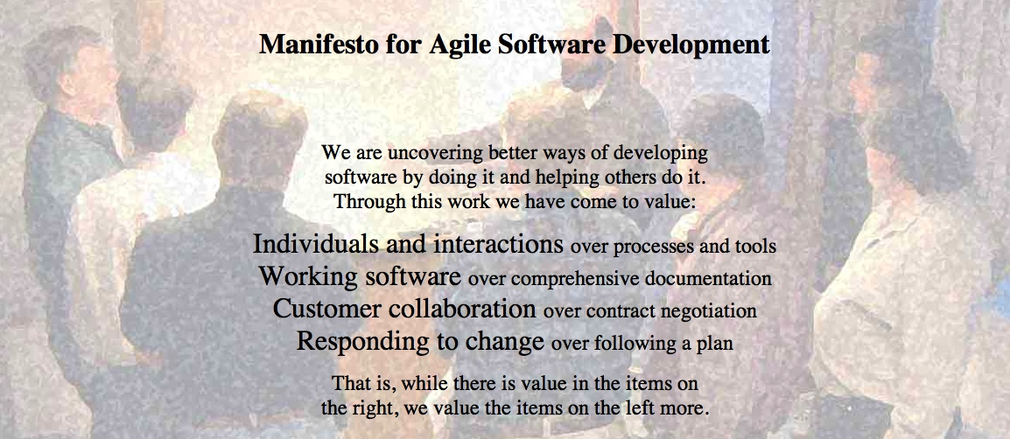
http://agilemanifesto.org
Began as a provocation: Plan-driven development did not safe the Software world…
Now a very serious movement, well adapted in industry.
There are a couple of established agile methods: How to integrate these values in everyday software development

Slide 34
?
Can the following projects be agile?
App development
Online shop
Mission controller for Airplane
Controller for nuclear plant

Slide 35
Agile Software development
Development
Pair programming
Team development (Repositories)
Requirements elicitation/Design
Testing/Verification/Validation
User stories (tasks)
The code is the documentation
Regular meetings with customer
Automated Unit testing
Test-driven development (TDD)
Acceptance tests

Slide 36
Agile processes
eXtreme programming (XP)
Scrum
Kanban
“Lean”
Crystal
ETC

Slide 37
Conclusions
Efficient software development requires a development process
Traditional processes
Not efficient when requirements change
Agile software development
Processes for efficient software development in the context of change

Slide 38
Agile Methods: eXtreme Programming (XP)
An approach based on the development and delivery of very small increments of functionality
No fine grained process description, but 12 practices arranged around short development circles (4-6 weeks)
“Turn-to-ten” metaphor (refers to volume setting of older amplifiers):
Reviewing is good? → Review continuously: Pair Programming
Early Tests are good? → Write tests before code: Test-First
Customer interaction is good? → Have Onsite-Customer
…

Slide 39

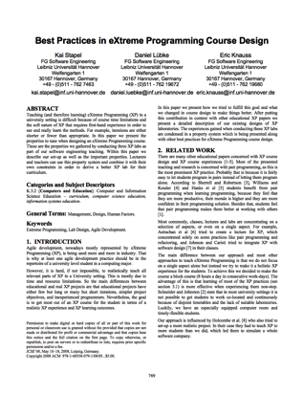
Planning Game
Business people need to decide
Scope, Priority, Composition of release, dates of release
Technical people need to decide
Estimates, Consequences, Process, Detailed scheduling
“Students learn how to divide requirements into User Stories and how to prioritize and estimate the costs of these stories. While such tasks seem to be easy in theory, dealing with dependencies in the planning game is normally a challenge for inexperienced developers like students.”
(+) More iterations, small teams, customer interested, technical support, progress feedback
(-) Longer iterations

Slide 40
Small releases
Every release
… should be as small as possible
… should contain the most valuable business requirements
… has to make sense as a whole
… should be delivered every 4-8 weeks (rather than 6-12 month)
“Students learn the benefits of small releases that already offer value to the customer and how to technically put a system into production including packaging.”
(+) More iterations, progress feedback

Slide 41
Metaphor
Examples
Naïve: “Contract management system deals with contracts, customers, and endorsements”
“Computer should appear as a desktop”
“Pension calculation is a spreadsheet”
Align team thinking
“Students learn how to develop a metaphor that helps every team member to better understand how the whole system works.”
(+) Technical support, technical feedback

Slide 42
Simple Design
The right design at any given time
Runs all the tests
Has no duplicated logic
States every intention important to the programmers
Has the fewest possible classes and methods
“Students learn the benefits of simple software design which improves their ability to change the system quickly and accommodate it to changing requirements.”
(+) More iterations, technical support

Slide 43
Testing
Any feature without automated test does not exist
Don’t write a test for every method
Write a test for every productive method that could possibly break
“Program becomes more and more confident over time”
“Students learn how to use unit test frameworks and the test-first approach to build high quality software and to recognize the advantages of well-tested code when making changes.”
(+) More iterations, technical support, technical feedback

Slide 44
Refactoring
Is there a way of changing the program to make it easier to add a new feature?
After adding the feature: Can we simplify the design?
Important investment!!!
“Students learn to refactor the software to remove duplication, improve communication and simplify the code base. Especially refactoring large systems can be troublesome and is a worthy experience that can only be made in long lasting projects.”
(+) More iterations, customer interest, technical support

Slide 45


Pair Programming
Driver: Has the keyboard, writes the code
Navigator: Thinking strategically
Will this work? Which test cases might not work? Can we simplify?
“Students learn and experience the principles of pair programming, the advantages of writing software with a partner and the social challenges that are associated.”
(+) Block course, small team size, technical support
(-) Long iterations

Slide 46
Collective Code Ownership
“Anybody who sees an opportunity to add value to any portion of the code is required to do so at any time.”
No code ownership → Chaos
Individual code ownership → Stable but slow
“Students get to know the advantages of collective code ownership and the challenges that arise with parallel updates and changes to their own code by other team members. ”
(+) Block course, small team size

Slide 47
Continuous Integration
Integrate and test code every few hours (1 day at the most)
Dedicated machine helps
If Machine is free: pair sits down, integrates their changes, tests, and does not leave before 100% of tests run
“To counter conflicting updates to the code base, students learn to integrate and build the software frequently. ”
(+) Block course, longer iterations, more iterations, small team size
(discovered later: technical feedback)

Slide 48
Sustainable pace (aka 40h week)
Be fresh every morning, tired every night
One week of overtime must not be followed by another one
“In contrast to normal life in university, students experience to work continuously for 40-hours per week in a designated team room.”
(+) Block course

Slide 49
On-Site Customer
Real customer in the room
Answers all questions now (…and can revise answer later)
Customer proxy
Answer now more important than answer correct
“Students have to interact with a designated On-Site Customer who is available full-time to answer questions.”
(+) Block course, customer interest

Slide 50
Coding Standards
Swapping partners, changing concurrently all parts of the code…
Your code should better look consistently!
Once and only once rule
Emphasize communication
Adopted by whole team
“Students experience the importance of uniform coding conventions throughout the team especially when combined with collective code ownership. ”

Slide 51
XP Practices
Feedback
Pair Programming
Continuous process
Onsite-Customer
Small releases
Test-first
Continuous integration
Planning game
Refactoring
Shared understanding
Programmer welfare
Coding standards
Sustainable pace
Collective Code Ownership
System metaphor
Simple design

Slide 52
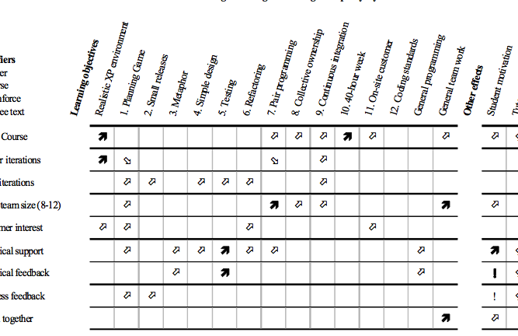
Overview: XP in Teaching

Slide 53
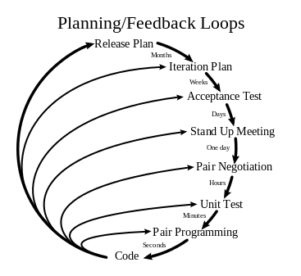
XP:

Slide 54
Thursday
Until Thursday: Reflect about the XP practices and how they fit together!
Continue with agile principles, processes and practices
Emil.Alegroth@chalmers.se

